Slide 1
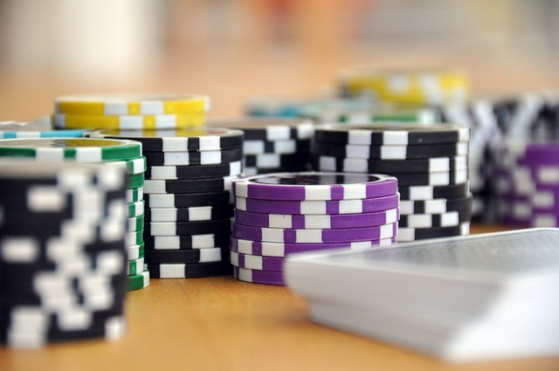
Project PHASE 2 Report JAAMN studios presents… JAAMN Casino BLACKJACK GOAT Phase 2

Slide 2
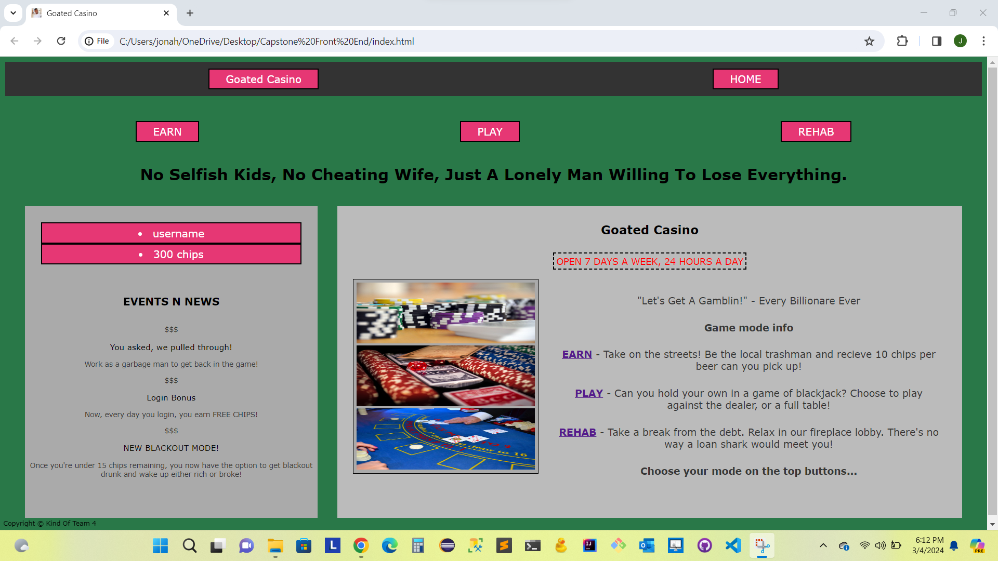
Homepage
- This is our Homepage featuring 5 buttons at the top for our different gameplay avenues or to return to home page
- On the left we have our news feed for updates and events
- On the right we have an explanation of each game mode

Slide 3
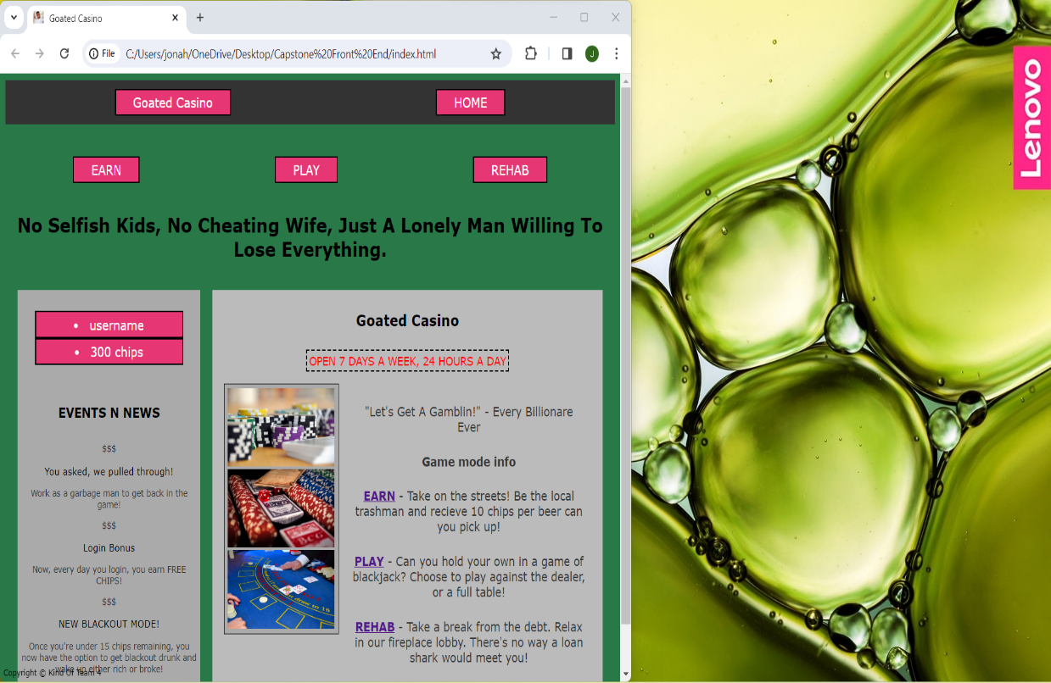
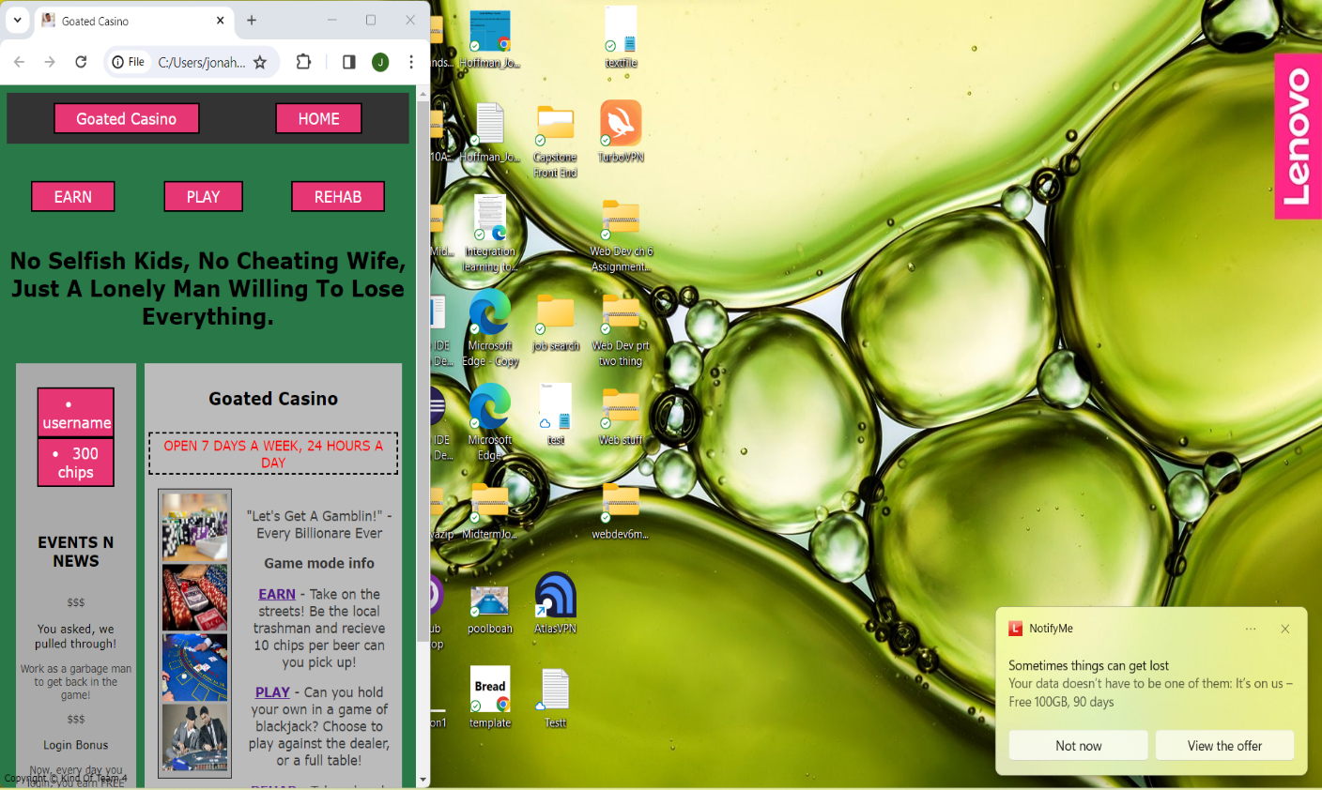
UI Scaling
- Here we are featuring the scalability of our homepage
- As you can see the homepage can be scaled to any size and still retain all its interactable buttons and all text
- Here the homepage is even further scaled, and you can see the user’s desktop in the background for comparison of size.
- As you can see the UI is still perfectly functional no matter the resolution of the webpage window.

Slide 4
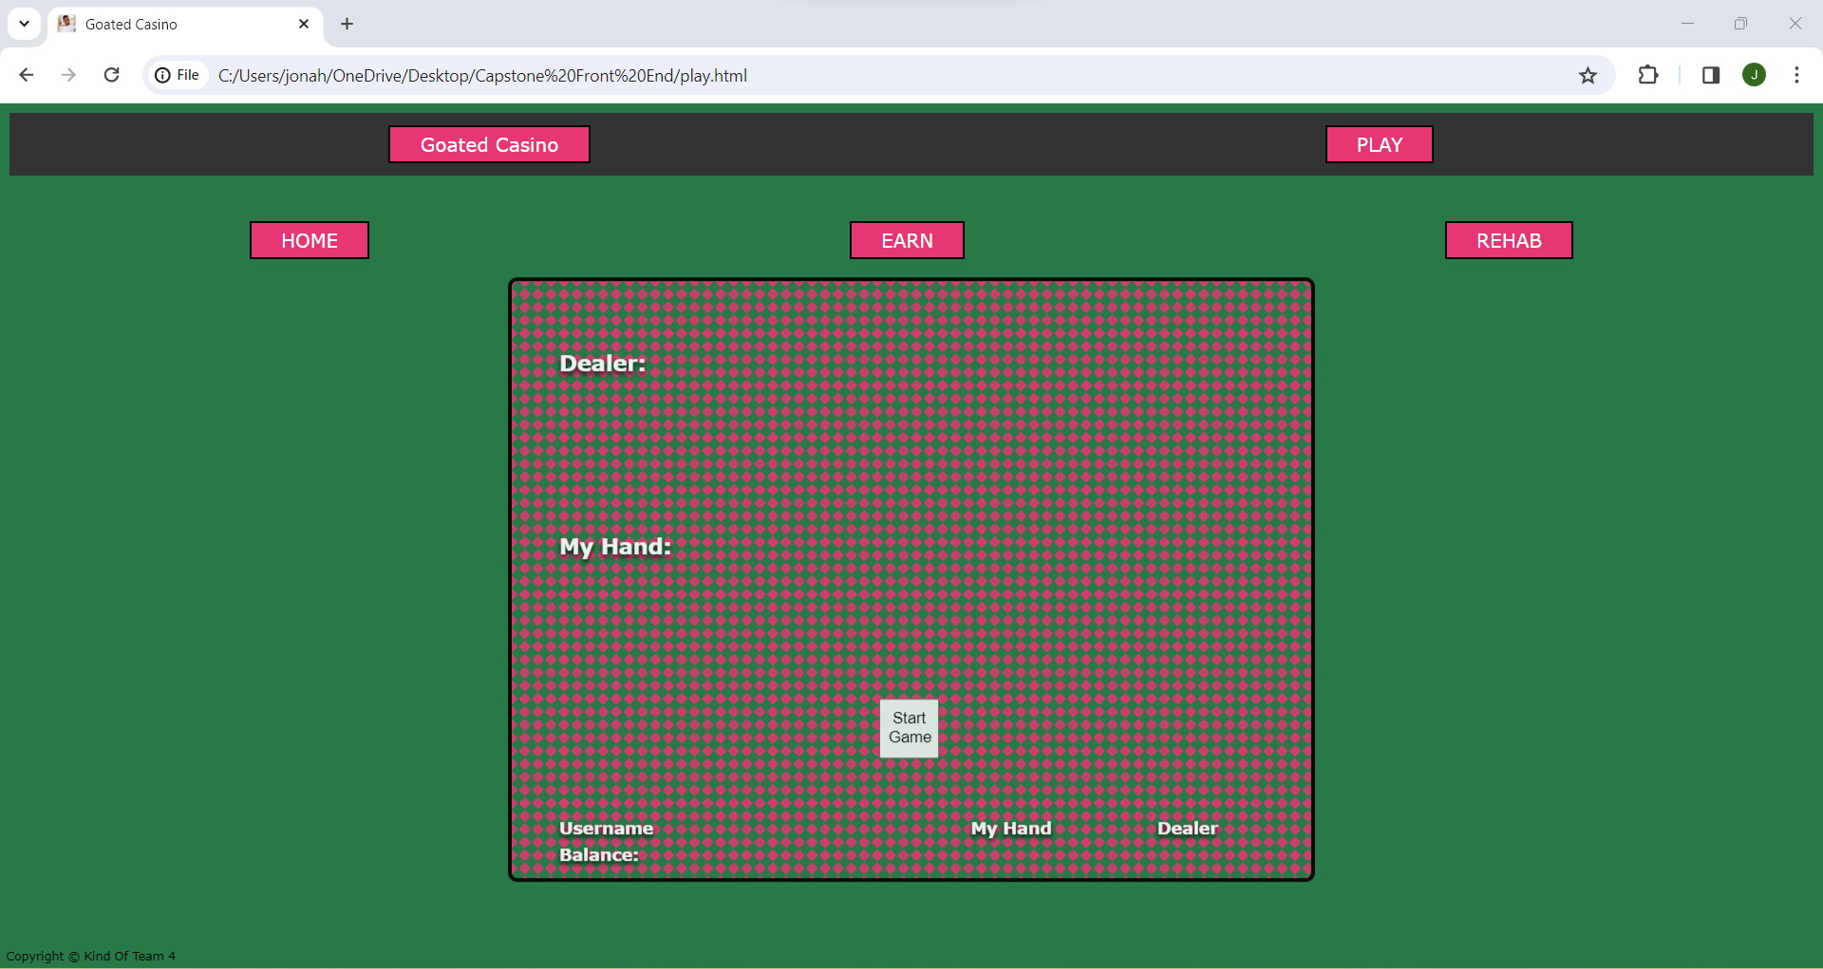
Fresh Game
- Here we have the UI that appears when ‘Play’ button is selected
- This is before cards are dealt
- In order to deal cards user must select ‘Start Game’ button in the center of the table
- We have not yet implemented customization of the table felt background this is to come in a future phase..

Slide 5
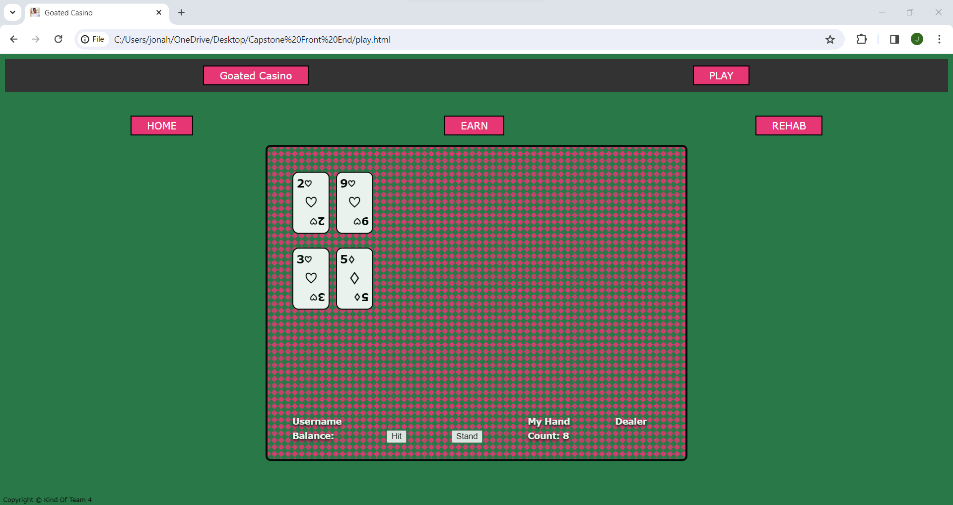
Cards Dealt
- This is the screen after clicking ‘Start Game’ in the center of the table
- You’ll notice two cards have been dealt to each the dealer and the user
- You will see your hand is then totaled in the bottom right of the UI and you are given two options to either ‘hit’ or ‘stand’
- Further implementation of ‘Double down’ or ‘Splitting’ pocket pairs is to come…

Slide 6
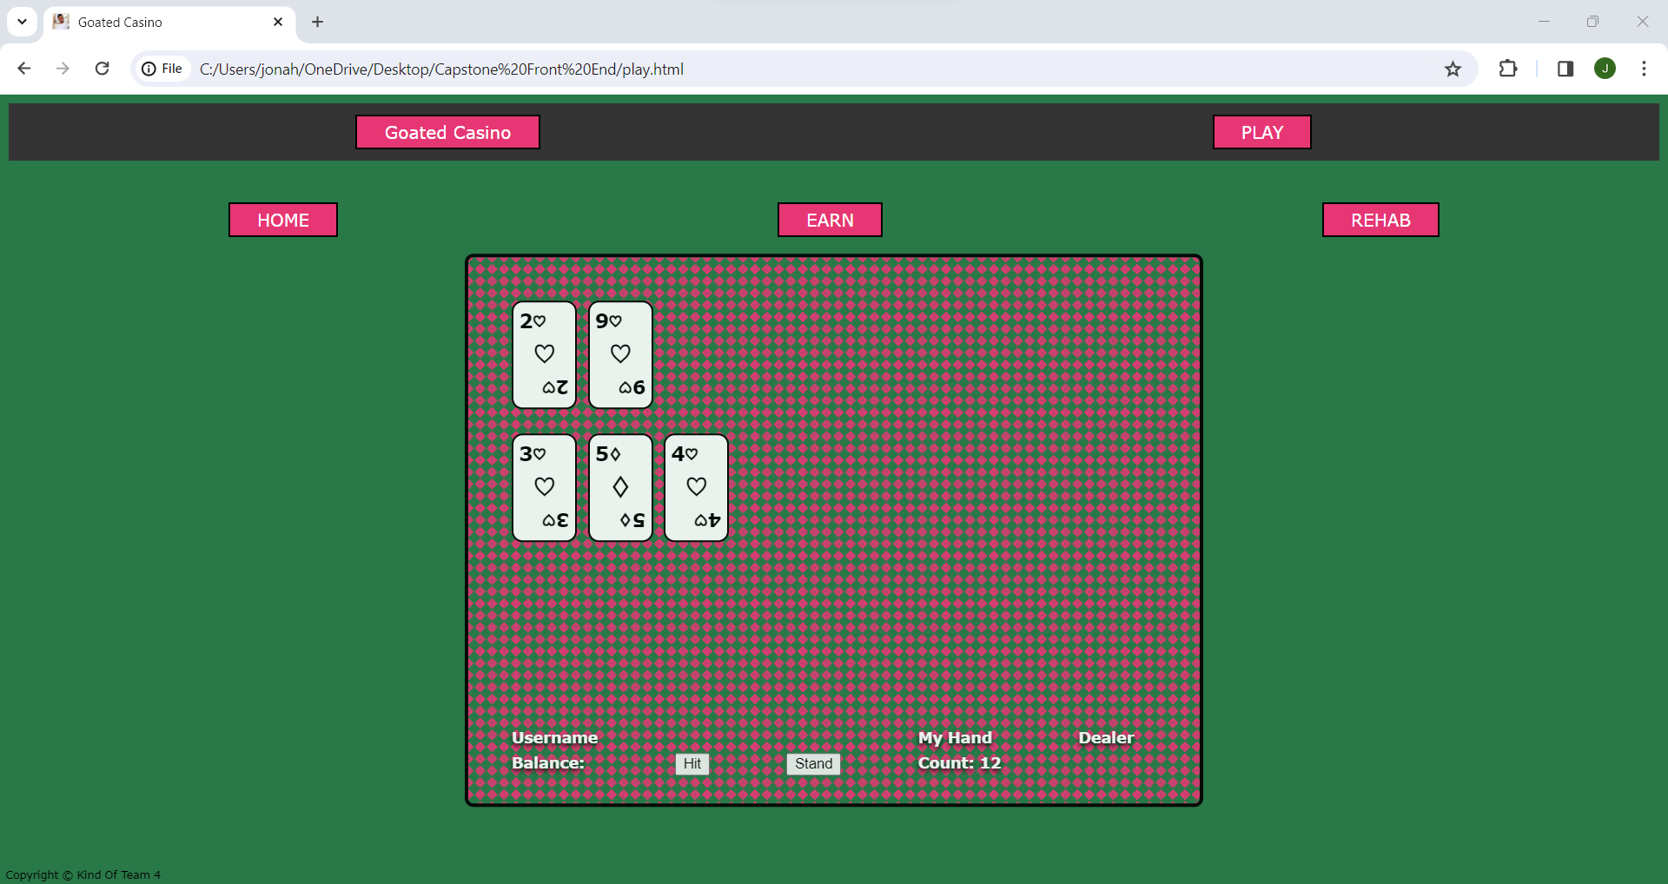
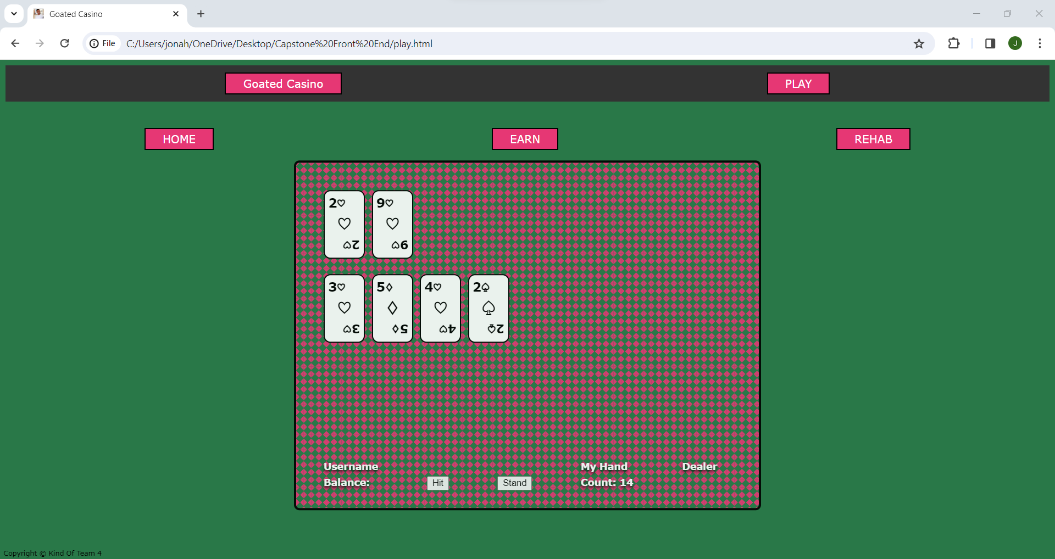
Selecting ‘Hit’
- After the user selects ‘Hit’ you can see another card is dealt to the user and your hand total is updated in the UI
*Notice all buttons are still accessible on the Page and at any moment user can exit and forfeit the hand*
More ‘Hits’
- The user then decides to ‘Hit’ again, is dealt another, and total is updated once more in the UI.
- The user is able to hit as many times as they’d like until they ‘Bust’ (hand total becomes 22 or more)

Slide 7
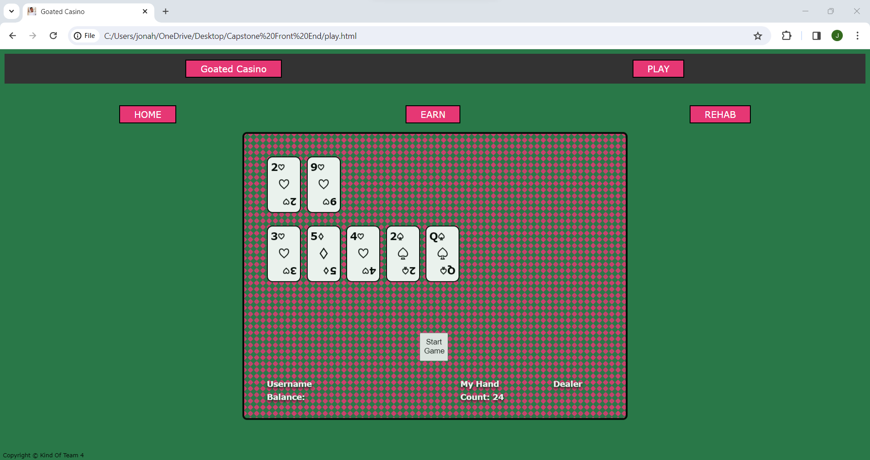
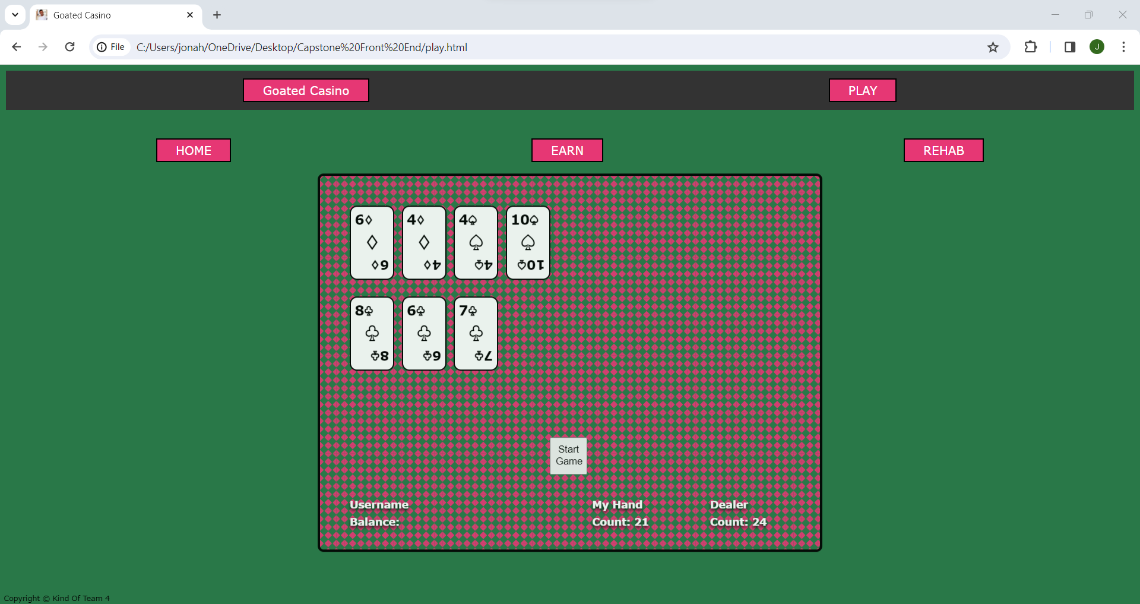
‘Bust’ Example
- In this screenshot you see an example of the user’s hand exceeding 21 which will result in a ‘Bust’ or loss..
- Further implementation of a visual that shows the user has ‘Bust’ to come…
‘Win’ Example
- However, in this screenshot you will see the user has won
- The user has received 21 as their hand total and the dealer has gone ‘Bust’ with a 24-hand total
- Further implementation of a visual representation of this to come as well…

Slide 8
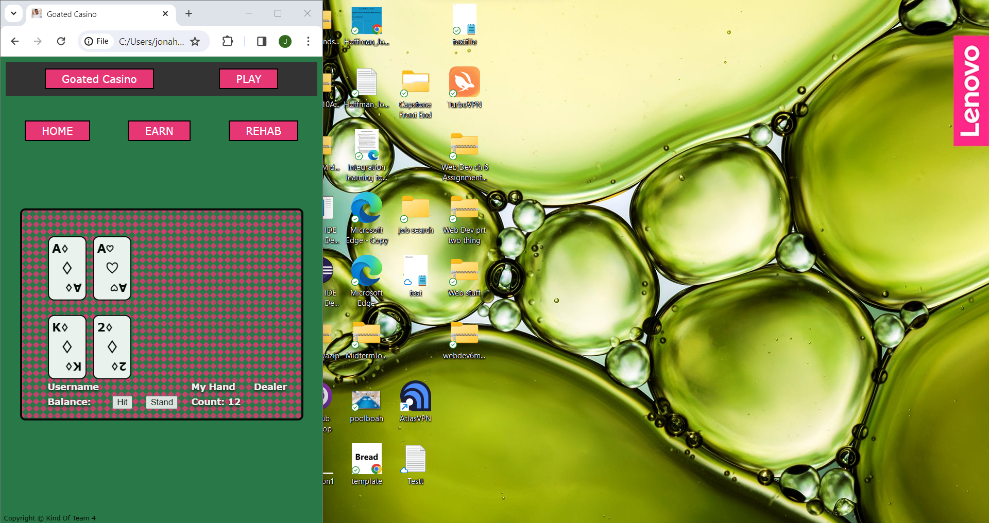
- In this screenshot we show that even during blackjack gameplay the window is still scalable to any size
- Scaling the window to your liking will not result in any loss of functionality as all assets and gameplay features will still be visible
- You can see the user’s desktop in the background for confirmation of this scalability

Slide 9
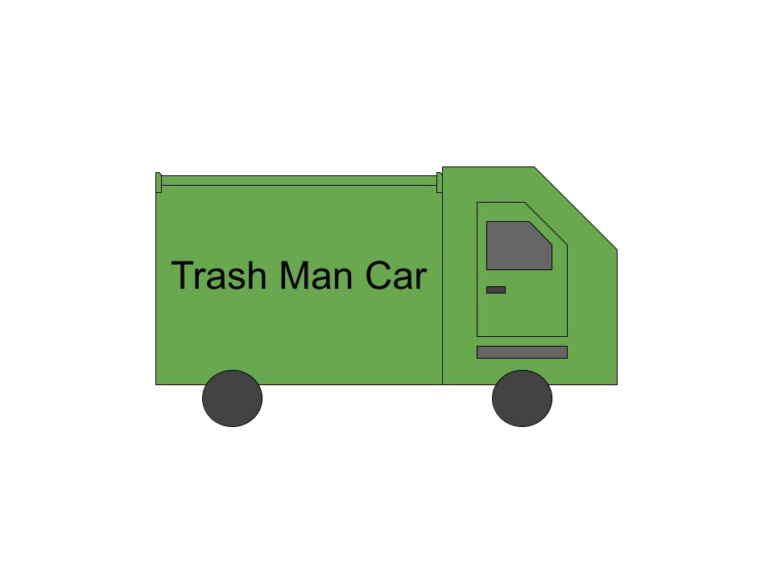
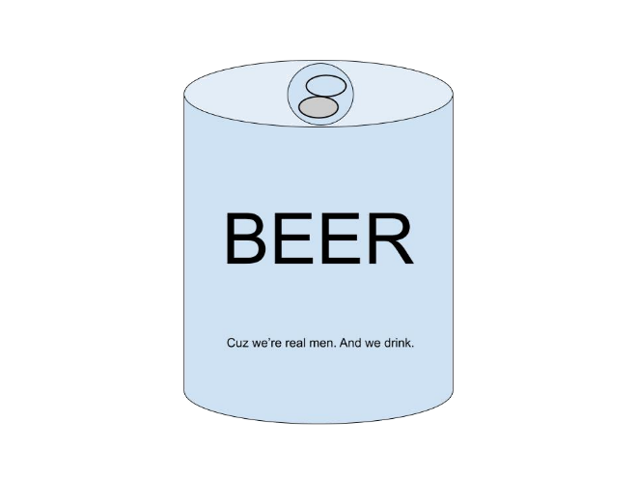
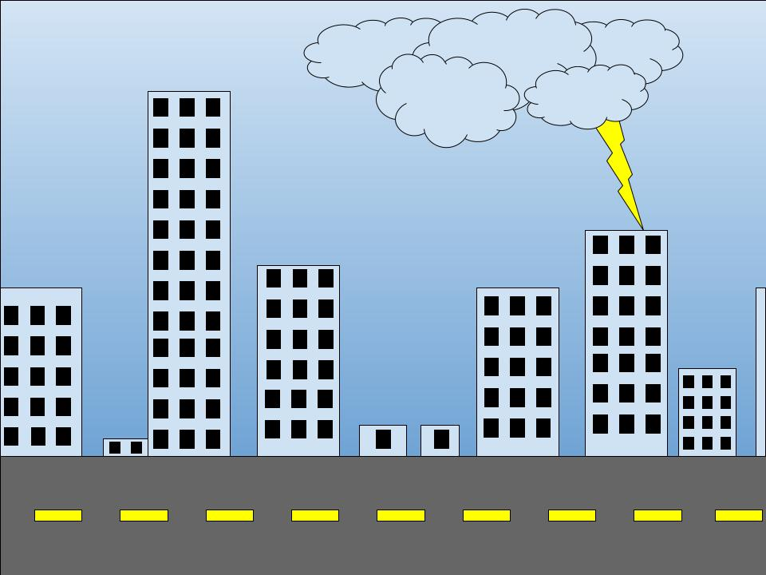
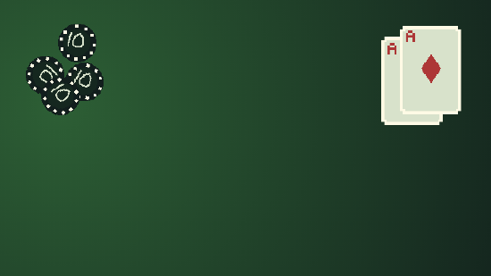

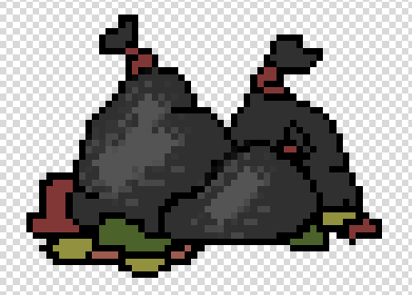
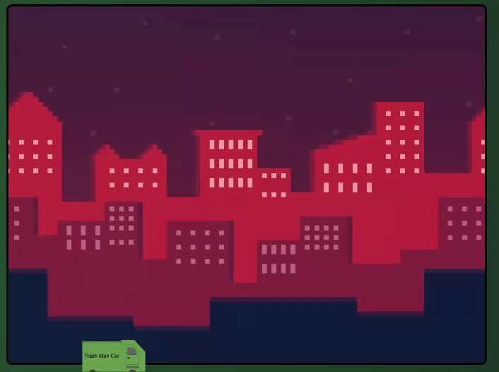
Assets
- This page displays our currently custom created assets that will be used
- 2 different background choices for ‘earn’ gameplay
- A different possible table background
- A beer can and trash bag asset to be used during ‘Earn’ gameplay
- The trash car you drive during ‘earn’ gameplay

Slide 10
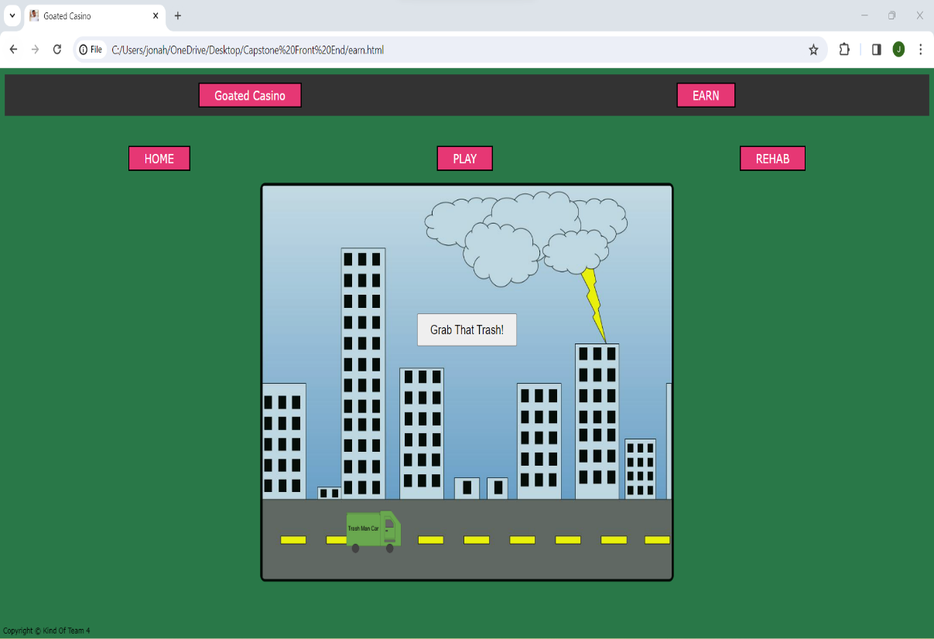
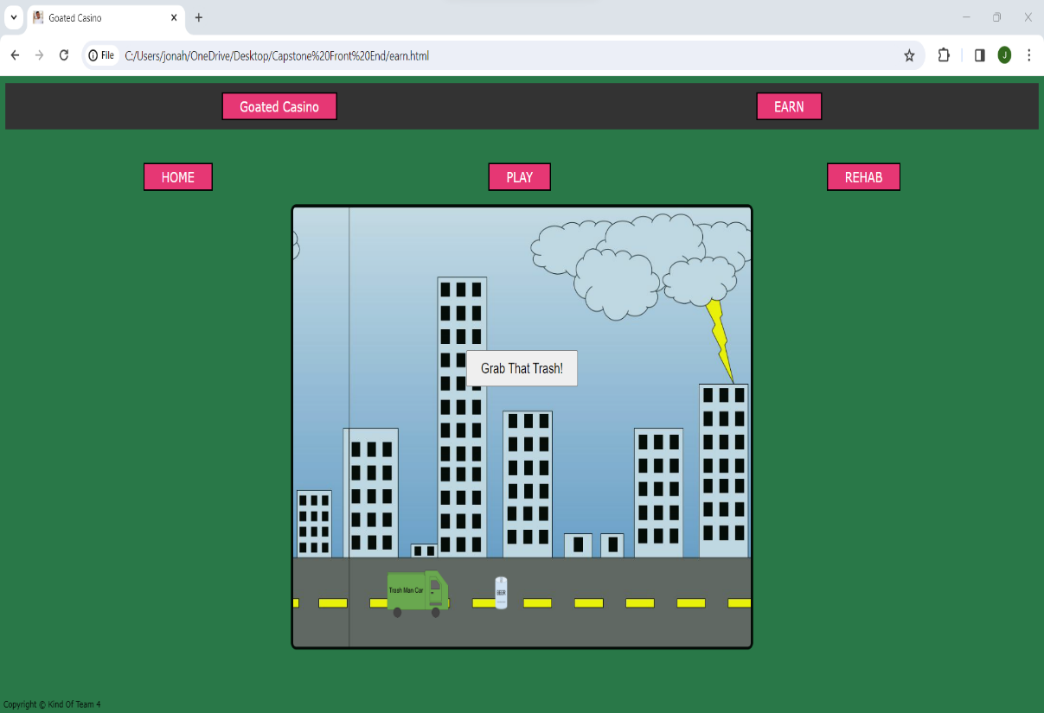
‘Earn’ Gameplay
- Here you see our ‘Earn’ gameplay start screen with and without the beer can asset to pickup
- ‘Earn’ gameplay is an available gameplay option for users who are running low on chips and want to earn more via working as a trash collector
- User can enjoy cleaning the streets as the background scrolls and trash appears on the road
- We currently have two background choices for this ‘earn’ gameplay and more assets are being developed to use as trash
- Amount earned via trash pickup is still being determined and will be announced in a future phase…

Slide 11
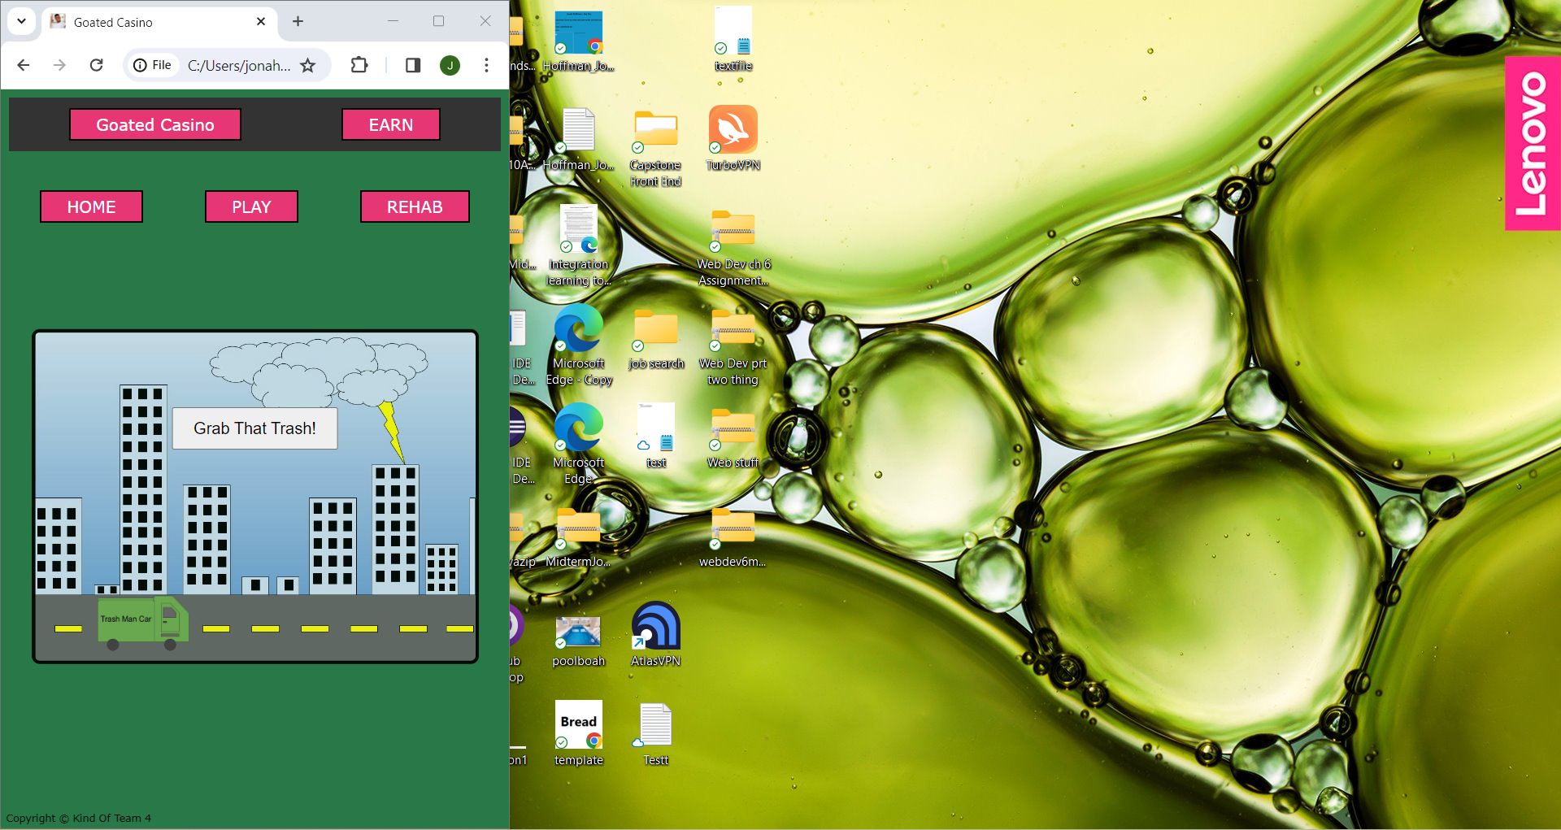
More UI Scaling Functionality
- As you can see our entire web application is UI scalable
- This is further displayed here with our ‘Earn’ gameplay
- All UI buttons at the top of the screen as well as the entire gameplay screen are still visible regardless of window sizing
- This is once again shown in relation to a user desktop background to express how UI friendly our application is!

Slide 12
API’s to be Implemented
- Google account compatibility
- Blackjack ‘Deck of Cards API’
Back End Query Design
- The queries we currently know of that will interact with our database system is our login screen account remembrance, our chip count, as well as any customization remembrance
Front End System Architecture
Login Page
Home Page
Rehab
Earn
Home
Play
(play and goated casino take you to the same page)

Slide 13
Thanks Again Shareholders!
We look forward to seeing you in Phase 3 to show some back end and further front-end development.

